Slide 1

Foreman
Building a tailored data assistant using dbt metadata
Speakers: Luís Ferreira and João Rebelo

Slide 2


Warehouse Foreman

Slide 3
Evolution of Data Warehousing
Traditional Data Warehouse:
On-premises infrastructure
High maintenance and operational costs
Limited scalability

Slide 4
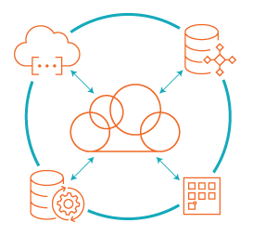
The Cloud Data Warehouse
Scalable
Cost Efficient
Performant
Integrated

Slide 5
The role of dbt and “Analytics Engineering”
Data Engineering
Analytics Engineering

Slide 6

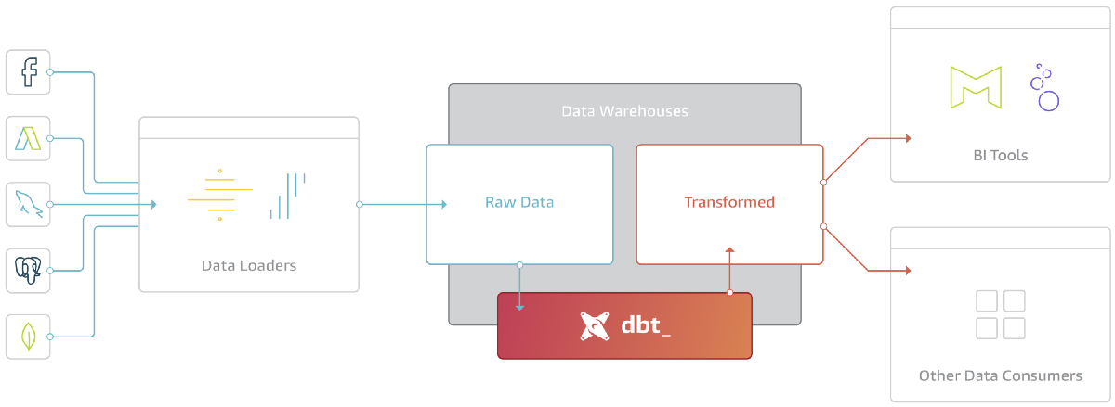
Dbt

Slide 7
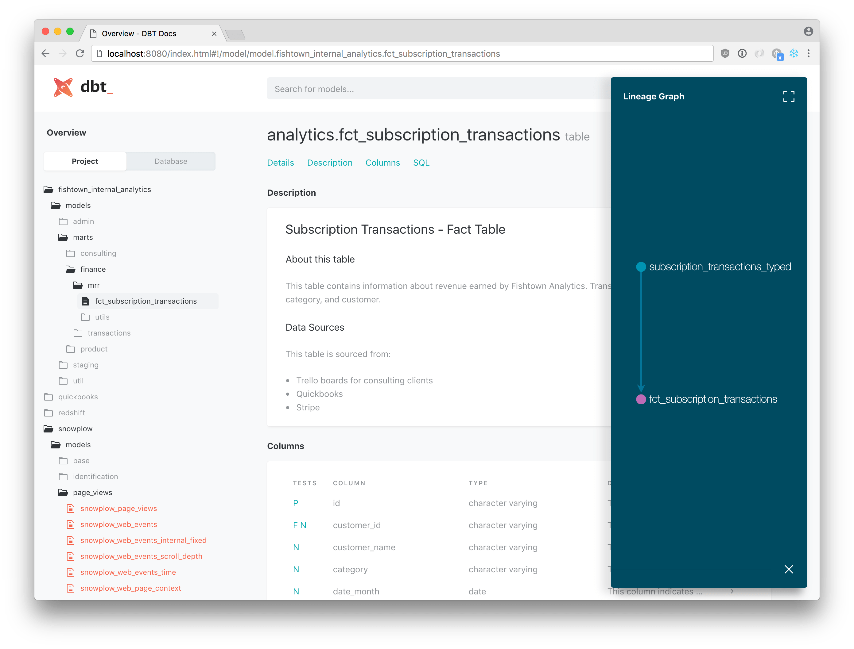
dbt docs
“Good documentation will help downstream consumers discover and understand the datasets you curate for them.”

Slide 8
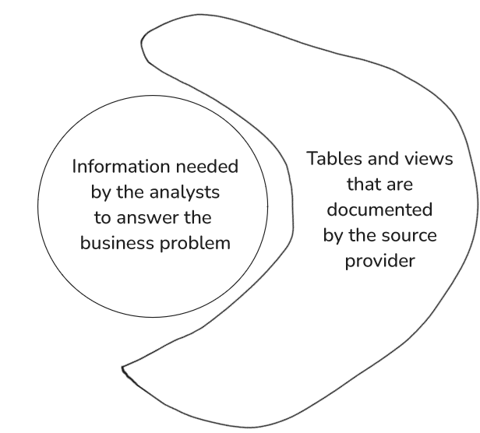
Data Warehouse: Common Problems

Slide 9
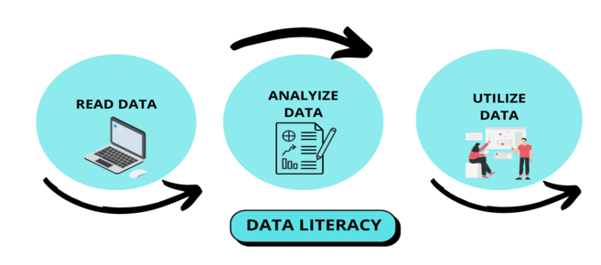
Enhancing Data Literacy
“The ability to read, understand, create, and communicate data as information.”

Slide 10
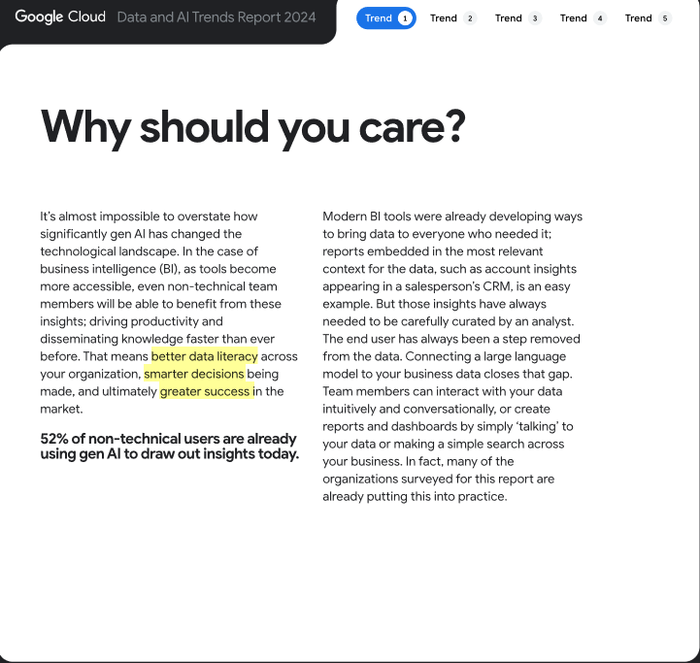
GenAI for Data Analytics & Data Literacy
“[…] better data literacy across your organization, smarter decisions being made, and ultimately greater success in the market.“
Source: Google’s Data And AI Trends Report 2024

Slide 11
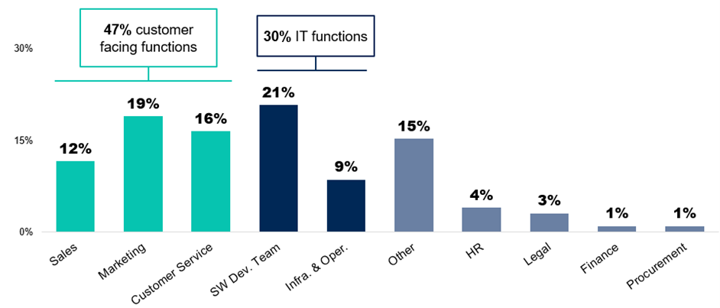
GenAI Investment by Business Function
Source: Gartner (October 2023)

Slide 12


The ‘Data Warehouse Foreman’
+
+

Slide 13
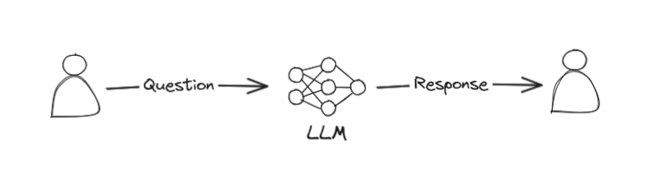
Retrieval Augmented Generation (RAG)
Simple prompt:

Slide 14
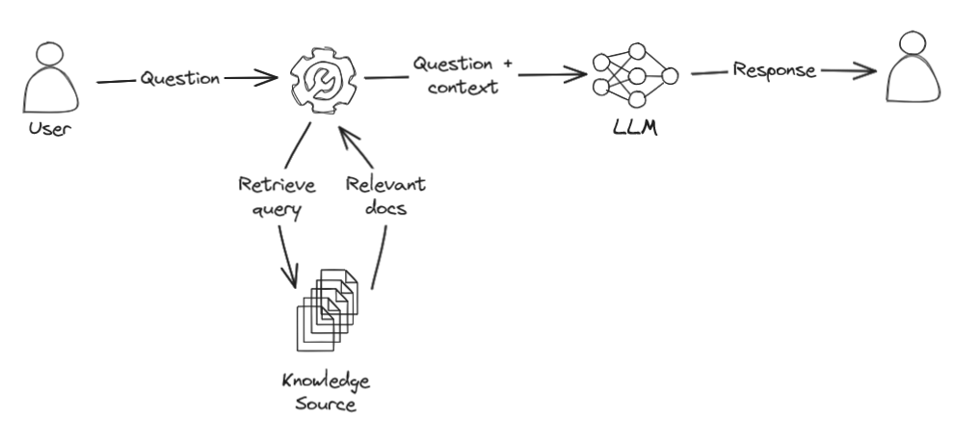
Retrieval Augmented Generation (RAG)
Prompt with RAG:

Slide 15
Retrieval Augmented Generation (RAG)
Prompt with RAG:

Slide 16
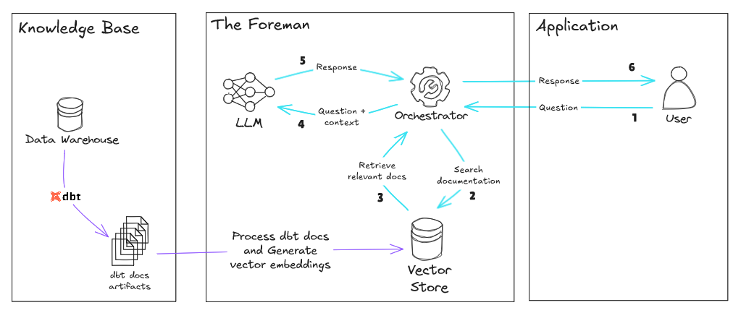
The ‘Foreman’ RAG

Slide 17





The ‘Foreman’ RAG

Slide 18



The ‘Foreman’ RAG

Slide 19



The ‘Foreman’ RAG

Slide 20
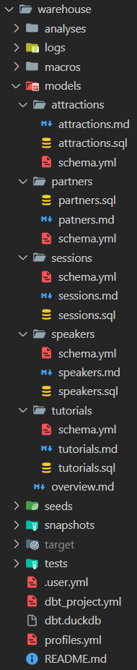
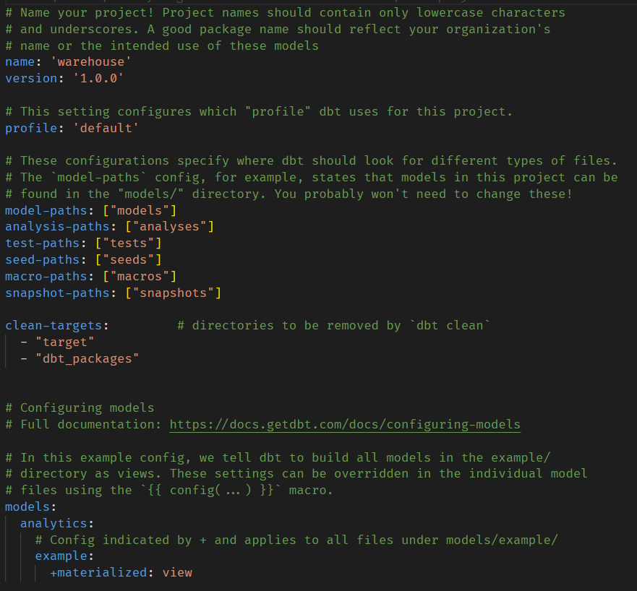
Example: Data Makers Fest
Models:
Attractions
Partners
Sessions
Speakers
Tutorials
dbt_project.yml
Folder structure

Slide 21
Questions with ‘base’ LLM
#1
21

Slide 22
Questions with ‘base’ LLM
#1
#2
22

Slide 23
Questions with ‘base’ LLM
#1
#2
#3
23

Slide 24
Questions with ‘base’ LLM
#1
#2
#3
#4
24

Slide 25
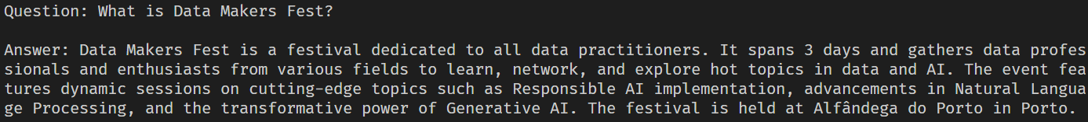
Questions with ‘Foreman’ using dbt docs
#1
25

Slide 26
Questions with ‘Foreman’ using dbt docs
#1
#2
26

Slide 27
Questions with ‘Foreman’ using dbt docs
#1
#2
#3
27

Slide 28
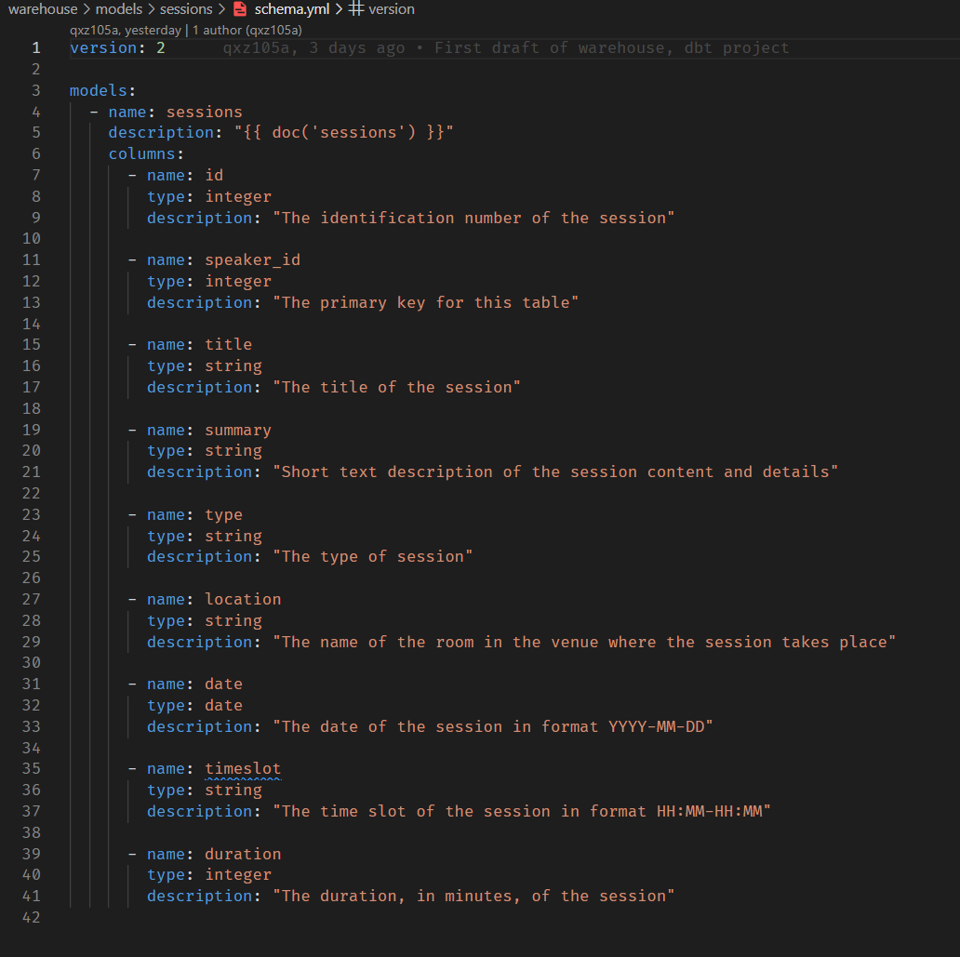
‘Foreman’ with Text-to-SQL instructions
dbt model for the ‘Sessions’ table
28

Slide 29
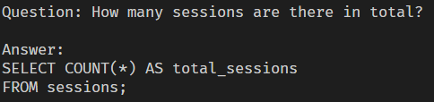
‘Foreman’ with Text-to-SQL instructions
#1
29

Slide 30
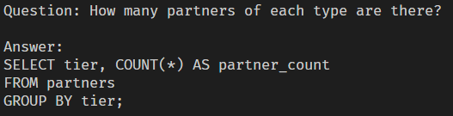
‘Foreman’ with Text-to-SQL instructions
#1
#2
30

Slide 31
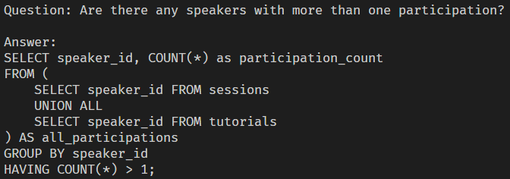
‘Foreman’ with Text-to-SQL instructions
#3
31

Slide 32
Road to production: Bitter lessons
“Once you get past demo datasets, the performance drops”
Databricks: “Text2SQL is Not Enough”¹
Snowflake: “Need for a semantic model”²
Numbers Station AI (Text-to-SQL start-up): “Text-to-SQL Failures on Enterprise Data”³

Slide 33

Embracing the Foreman
“Goods sit in the warehouse until information moves them.”
C. J. Cherryh (science-fiction writer)

Slide 34




Thank you!
luisferreira97
luisferreira97/foreman
joaocrebelo

